Slide 1
Principle Component Analysis
Dimension Reduction

Slide 2
Dimension Reduction
Principal Component Analysis

Slide 3
Dimension Reduction
How to reduce dimension of data
Assume that data is generated by a normal distribution

Slide 4
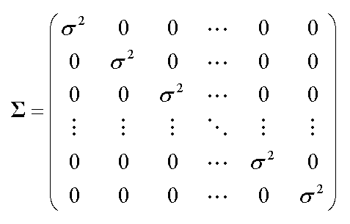
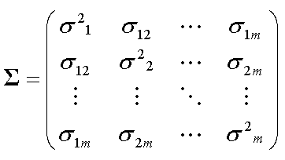
Dimension Reduction
How to reduce dimension of data
Assume that data is generated by a normal distribution
How much rotate?
Until covariance
matrix is diagonalized

Slide 5
Dimension Reduction
Steps
Let P be the rotational transform matrix

Slide 6
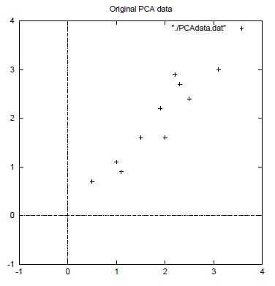


Example
Step1: Data -> Adjusted Data (data-mean)
Step2: Calculate the covariance matrix of X
Data
2.5 | 0.5 | 2.2 | 1.9 | 3.1 | 2.3 | 2.0 | 1.0 | 1.5 | 1.1
2.4 | 0.7 | 2.9 | 2.2 | 3.0 | 2.7 | 1.6 | 1.1 | 1.6 | 0.9
Adjusted Data
0.69 | -1.31 | 0.39 | 0.09 | 1.29 | 0.49 | 0.19 | -0.81 | -0.31 | -0.71
0.49 | -1.21 | 0.99 | 0.29 | 1.09 | 0.79 | -0.31 | -0.81 | -0.31 | -1.01
$$X=$$
$$XX^{T}=\left(\begin{matrix}0.6166 & 0.6154 \\ 06154 & 07166\end{matrix}\right)$$

Slide 7
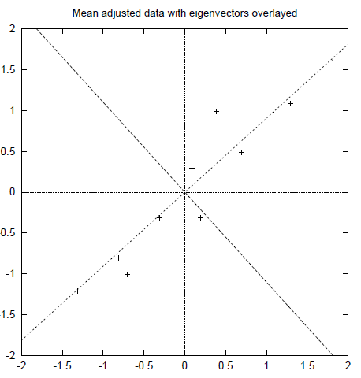
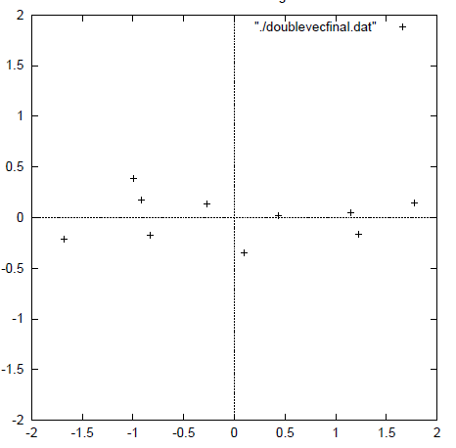



Example
Step3: Calculate the eigenvectors and eigenvalues of
$$λ_{1}=1.284 v_{1}=\left(\begin{matrix}−0.735 \\ 0.678\end{matrix}\right)$$
$$XX^{T}=\left(\begin{matrix}0.6166 & 0.6154 \\ 06154 & 07166\end{matrix}\right)$$
$$λ_{2}=0.490 v_{2}=\left(\begin{matrix}−0.678 \\ −0.735\end{matrix}\right)$$

Slide 8
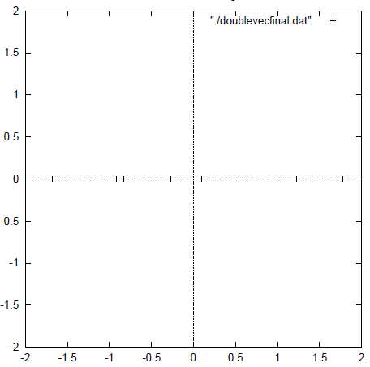





Example
Step5: Transform Data
$$Y=\left(\begin{matrix}−0.735 & 0.678 \\ −0.678 & −0.735\end{matrix}\right)X$$
-0.83 | 1.78 | -0.99 | -0.27 | -1.68 | -0.91 | -0.10 | 1.14 | 0.44 | 1.22
-0.18 | 0.14 | 0.38 | 0.13 | -0.21 | 0.17 | -0.35 | 0.05 | 0.02 | -0.16
$$Y=$$
$$Y=\left(\begin{matrix}−0.735 & 0.678 \\ 0.0 & 0.0\end{matrix}\right)X$$
$$Y=\left(\begin{matrix}−0.735 & 0.678\end{matrix}\right)X$$
$$Y=$$
-0.83 | 1.78 | -0.99 | -0.27 | -1.68 | -0.91 | -0.10 | 1.14 | 0.44 | 1.22

Slide 9
Limitation
PCA is a linear transform
Kernel PCA
Mean and variance are sufficient statistics
Eg) Normal distribution
Large variances have important dynamics
Principal components are orthogonal
Intuitive assumption, but not necessarily
An assumption for using linear algebraic solution

